Slide 1

SALES PERFORMANCE ANALYSIS OF
ABC ELECTRONICS
PRESENTED BY
SATHYANARRAYANAN

Slide 2

OBJECTIVE
To perform data cleaning and analysis to evaluate sales performance across regions and product categories, and develop a dynamic dashboard that highlights key trends and top-performing segments for strategic decision-making.
Key Deliverables:
A cleaned and structured dataset ready for analysis.
An interactive dashboard summarizing sales performance metrics.
Basic regression analysis showing the relationship between discounts and sales.

Slide 3
OVERALL SALES AND PROFIT PERFORMANCE
TOTAL SALES
TOTAL PROFIT
Total Sales and Profit displayed as per Region

Slide 4
OVERALL SALES AND PROFIT PERFORMANCE
TOTAL SALES
TOTAL PROFIT
Total Sales and Profit displayed as per Product category

Slide 5
REGIONAL PERFORMANCE ANALYSIS
Profit Performance: The East region has the highest profit (1,052K), followed by the South with 1,011K.
Sales Performance: The East region also led in total sales with 2595K.
Profit Margin: The East also leads in profit margin at 101%, with the South close behind at 98%.
North Region Insight: Despite having total sales nearly equal to the East, the North region is underperforming in both profit and profit margin.

Slide 6
PRODUCT CATEGORY INSIGHT
Sales Performance: Clothing emerged as the top-performing category in terms of total sales, generating 2,156K the highest among all categories.
Profit Margin Analysis: Clothing also led in total profit with 856K. However, Electronics outperformed in terms of profit margin, achieving 97%, slightly ahead of Clothing’s 96%.
Low-Performing Categories: Grocery recorded the lowest sales and profit across all categories. Additionally, despite moderate sales, the Sports category showed the lowest profit margin, indicating a need for cost or pricing review.

Slide 7
DISCOUNT VS SALES – REGRESSION INSIGHT
The regression analysis shows a very weak relationship between discount percentage and sales amount (R² = 0.0003).
This suggests that discounts have minimal impact on driving sales in this dataset.

Slide 8
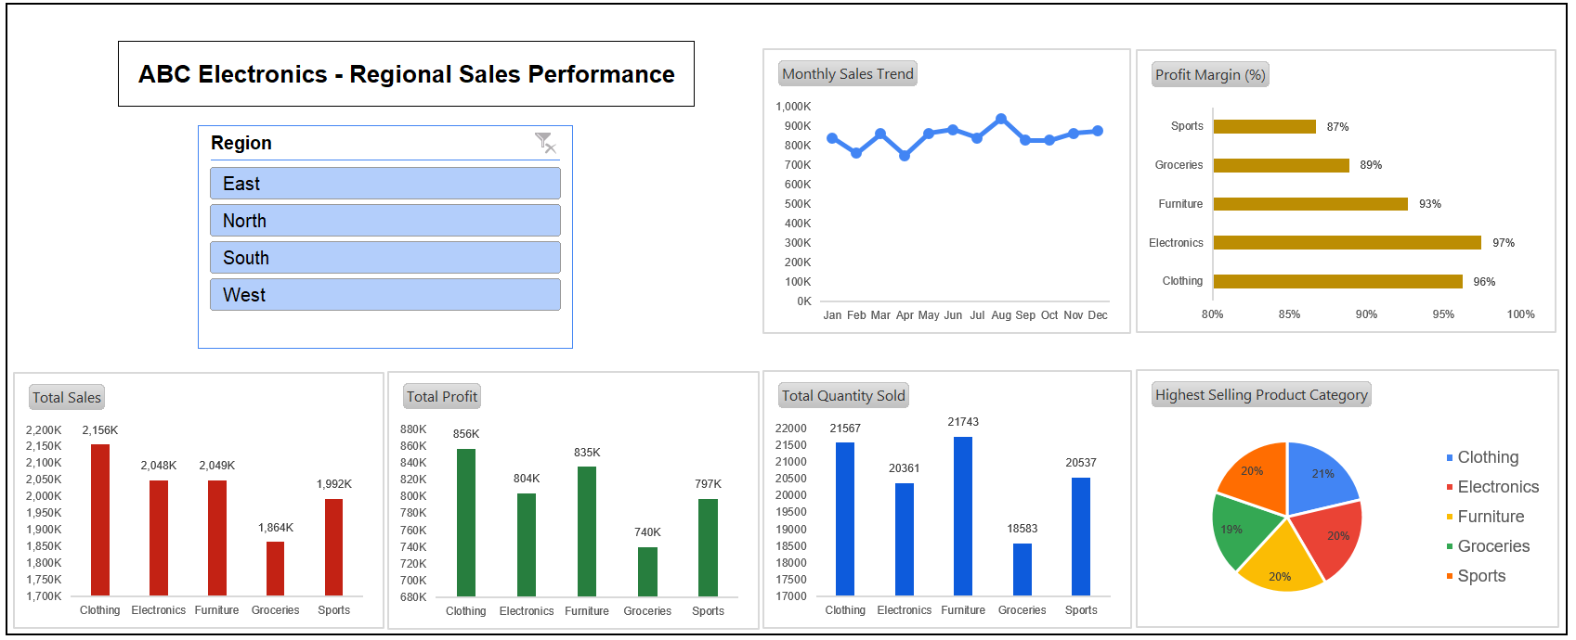
INTERACTIVE DASHBOARD

Slide 9
STRATEGIC RECOMMENDATION
Focus on East Region – It leads in sales, profit, and profit margin; ideal for future growth campaigns and product launches.
Improve North Region Profitability – Despite strong sales, low profit and margin suggest a need to optimize pricing and reduce costs.
Prioritize Clothing & Promote Electronics – Clothing drives the highest sales and profit, while Electronics offers the best margin—both should be key focus areas.
Review Low-Performing Categories – Grocery and Sports need attention; consider pricing adjustments, cost control, or product re-evaluation.

